Slide 1
Velocity (Eulerian approach)
v_{x} = gka/σ [cosh [k(y+h)]/cosh(kh)]cos[k(xcosθ+zsin θ)- σt]
v_{y} = gka/σ [sinh [k(y+h)]/cosh(kh)]sin[k(xcosθ+zsin θ)- σt]
In the next figure we show the behaviour from deep water to sahallow water

Slide 3
Acceleration
a_{x} = v_{x,t}+ [(v_{x}² +v_{y}²)/ 2],_{x}
a_{y} = v_{y,t}+ [(v_{x}² +v_{y}²)/ 2],_{y}
That assume the following espression on deep water and on shallow water
a_{x}=(gka) exp(ky) a_{x}~(gka)
a_{y}= (gka)exp(ky) a_{y}= (gka) ks

Slide 4
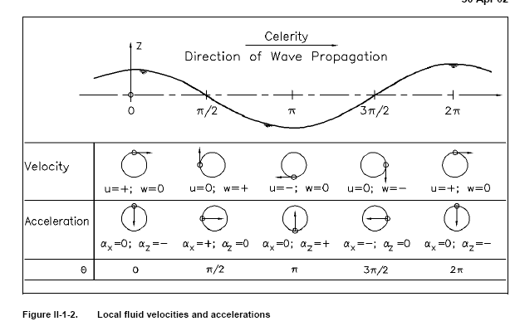

Slide 5
The Stream Function is Ψ,_{y} = φ,_{x} - Ψ,_{x} = φ,_{y} Ψ= ga/σ[sinh (ks)/cos(kh)]cosθ and consequenlty the current line are described by ga/σ[sinh (ks)/cos(kh)]cosθ = costante

Slide 7
To evaluate on a dynamic approach it is necessary to define the pressure that it is obtained adopting the Bernoulli eq. In irrotanionl flow, as p/ρ + gy + [(φ,_{x})²+ [(φ,_{y})²]/2 + φ,_{t}=0 that at the I ordine became p/ρ + gy + φ,_{t}=0 and introducing the axix s is p= -ρg(s-h) + ρgη[cosh(ks)/cosh(kh)] That shows the hydrostatic componente and the dynamic component that it is proportional to the response factor K_{p}= cosh(ks)/cosh(kh) See next Figure 10

Slide 9
Total energy of sea state = Kinetical en. + Potential en. E_{p}(θ)= ∫ ρgydy only over the mean sea water level E_{c}(θ)= ∫ ρ [(v,_{x})²+ (v,_{y})²/2 ]dy only under the mean sea water level over a period equale to 2 π, E_{p}=E_{c}= ρgH²/8 on deep water and on shallow water conditions

Slide 10
Instantaneous, local energy flux due to wave motion and related to a vertical section perpendicular to the direction of propagation and extending from the bottom to the free surface expressed by E_{f} = ∫[p_{d}+ρ [(v,_{x})²+ (v,_{y})²/2 ] v,_{x}dy introducing some approximation and semplifications we obtain E_{f}=Ec_{g} on deep water and in shallow water became E_{f}=( ρga²/2)c/2 E_{f} ~ =( ρga²/2)c

Slide 12
The superposition of wave trains with equal amplitude but wave numbers and angular frequencies that differ from each other by small amounts δk and δσ gives rise to wave groups that propagate with a particular speed referred to as group velocity
c_{g}=c/2 [1+2kh/sinh(2kh)]
Where c= phase velocity
c=[(g/k) tanh(kh)]^{½}
Then on deep water and in shallow water became
c_{g}=c/2 c_{g}=c

