Slide 1
Impacts of disasters on coastal environments
Angela Celeste TARAMASSO PhD
angela.c.eleste taramasso@unige.it

Slide 2
Waves on the surface of the ocean with periods of 3 to 25 s are primarily generated by winds and are a fundamental feature of coastal regions of the world. Other wave motions exist on the ocean including internal waves, tides, and edge waves.
Knowledge of these waves and the forces they generate is essential for the design of coastal projects since they are the major factor that determines the geometry of beaches, the planning and design of marinas, waterways, shore protection measures, hydraulic structures, and other civil and military coastal works.
Regular Waves and Irregular Waves.

Slide 3
Regular Waves
The objective is to provide a detailed understanding of the mechanics of a wave field through examination of waves of constant height and period.
Irregular Waves
The objective is to describe statistical methods for analyzing irregular waves (wave systems where successive waves may have differing periods and heights) which are more descriptive of the waves seen in nature.
In looking at the sea surface, it is typically irregular and three-dimensional (3-D). The sea surface changes in time, and thus, it is unsteady. At this time, this complex, time-varying 3-D surface cannot be adequately described in its full complexity; neither can the velocities, pressures, and accelerations of the underlying water required for engineering calculations.

Slide 4
Regular Waves - the simplest mathematical representation assuming ocean waves are two-dimensional (2-D), small in amplitude, sinusoidal, and progressively definable by their wave height and period in a given water depth. In this simplest representation of ocean waves, wave motions and displacements, kinematics (that is, wave velocities and accelerations), and dynamics (that is, wave pressures and resulting forces and moments) will be determined for engineering design estimates. When wave height becomes larger, the simple treatment may not be adequate and the representation requires using more mathematically complicated theories. These theories become nonlinear and allow formulation of waves that are not of purely sinusoidal in shape.

Slide 5
Irregular Waves - an alternative description of ocean waves.
It is necessary to utilize statistical methods for describing the natural time-dependent three-dimensional characteristics of real wave systems. A complete 3-D representation of ocean waves requires considering the sea surface as an irregular wave train with random characteristics. To quantify this randomness of ocean waves it is necessary to employ statistical and probabilistic theories. Even with this approach, simplifications are required. One approach is to transform the sea surface using Fourier theory into summation of simple sine waves and then to define a wave’s characteristics in terms of its spectrum.
The second approach is to describe a wave record at a point as a sequence of individual waves with different heights and periods and then to consider the variability of the wave field in terms of the probability of individual waves.

Slide 6
The major generating force for waves is the wind acting on the air-sea interface. A significant amount of wave energy is dissipated in the nearshore region and on beaches. Wave energy forms beaches; sorts bottom sediments on the shore face; transports bottom materials onshore, offshore, and alongshore; and exerts forces upon coastal structures.
A basic understanding of the fundamental physical processes in the generation and propagation of surface waves must precede any attempt to understand complex water motion in seas, lakes and waterways

Slide 7
An introduction to wave mechanics focused on simple water wave theories for coastal engineer, in particular methods for estimating wave surface profiles, water particle motion, wave energy, and wave transformations due to interaction with the bottom and with structures.
The simplest wave theory is the first-order, small-amplitude, or Airy wave theory (linear theory). Many engineering problems can be handled with ease and reasonable accuracy by this theory. For some situations, simple theories provide acceptable estimates of wave conditions.
When waves become large or travel toward shore into shallow water, higher-order wave theories are often required to describe wave phenomena. These theories represent nonlinear waves.

Slide 8
Any basic physical description of a water wave involves both its surface form and the water motion beneath the surface.
A wave that can be described in simple mathematical terms is called a simple wave. Waves comprised of several components and difficult to describe in form or motion are termed wave trains or complex waves.
Sinusoidal or monochromatic waves are examples of simple waves, since their surface profile can be described by a single sine or cosine function.
A wave is periodic if its motion and surface profile recur in equal intervals of time termed the wave period.
A wave form that moves horizontally relative to a fixed point is called a progressive wave and the direction in which it moves is termed the direction of wave propagation.
A progressive wave is called wave of permanent form if it propagates without experiencing any change in shape.
Notes:
Beneath the surface sotto la superficie

Slide 9
In coastal practice we found two types of surface waves. These are seas and swells.
Seas refer to short-period waves still being created by winds. Swells refer to waves that have moved out of the generating area. In general, swells are more regular waves with well-defined long crests and relatively long periods.
The growth of wind-generated oceanic waves is not indefinite. The point when waves stop growing is termed a fully developed sea condition, seas are short-crested and irregular and their periods are within the 3- 25 s range. Seas usually have shorter periods and lengths, and their surface appears much more disturbed than for swells.
Waves assume a more orderly state with the appearance of definite crests and troughs when they are no longer under the influence of winds (swell).
Notes:
Swell onda lunga

Slide 10
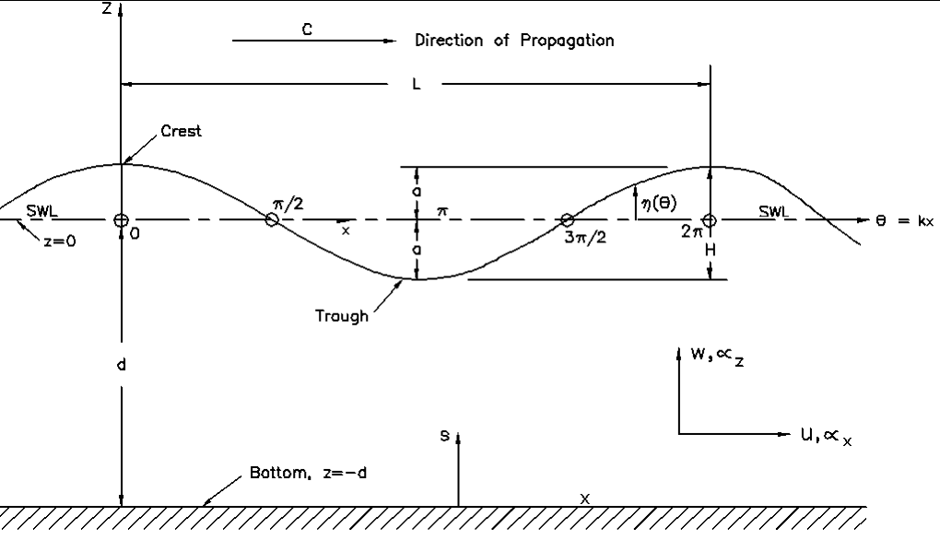

Slide 11
A progressive wave may be represented by the variables x (spatial) and t (temporal) or by their combination (phase), defined as θ = kx - ωt, where k and ω are described in the following. The values of θ vary between 0 and 2π.
The previous figure depicts parameters that define a simple, progressive wave as it passes a fixed point in the ocean.
A simple, periodic wave of permanent form propagating over a horizontal bottom may be completely characterized by the wave height H, wavelength L and water depth d.

Slide 12
The highest point of the wave is the crest and the lowest point is the trough.
For linear or small-amplitude waves, the height of the crest above the still-water level (SWL) and the distance of the trough below the SWL are each equal to the wave amplitude a. Therefore a = H/2, where H = the wave height.
The time interval between the passage of two successive wave crests or troughs at a given point is the wave period T.
The wavelength L is the horizontal distance between two identical points on two successive wave crests or two successive wave troughs.

Slide 13
Other wave parameters include ω = 2π/T the angular or radian frequency, the wave number k = 2π/L, the phase velocity or wave celerity C = L/T = ω/k, the wave steepness ε = H/L, the relative depth d/L, and the relative wave height H/d.
These are the most common parameters encountered in coastal practice. Wave motion can be defined in terms of dimensionless parameters H/L, H/d, and d/L; these are often used in practice.
The dimensionless parameters ka and kd, preferred in research works, can be substituted for H/L and d/L, respectively, since these differ only by a constant factor 2π from those preferred by engineers.

